Slide 1
Decision Making
Material extracted from IIMM, ISO 55000, IPWEA, NAMS

Slide 2
Decision Making
“Decision-making is regarded as the cognitive process resulting in the selection of a belief or a course of action among several alternative possibilities.
Decision-making is the process of identifying and choosing alternatives based on the values, preferences and beliefs of the decision-maker. Every decision-making process produces a final choice, which may or may not prompt action.”
Wikipedia
Decision making and its methods in an organisation can vary depending on the affected level (strategic/operational), availability & certainty of data, criteria complexity etc.

Slide 3
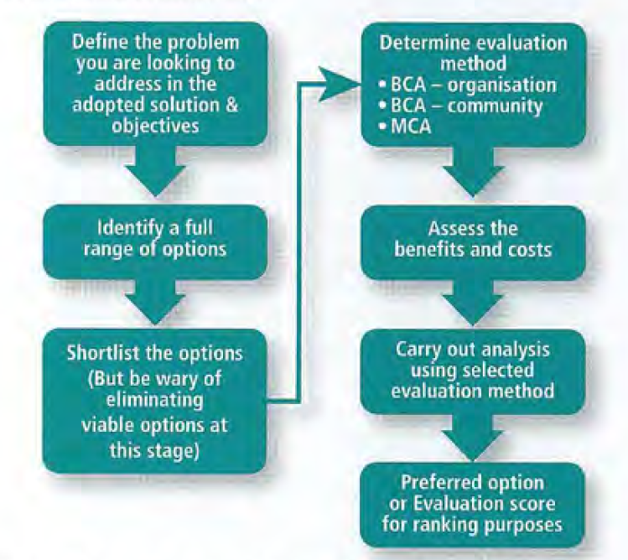
Decision Making Principles

Slide 4
Risk - Cost - Performance
The Balance
Ryde Council

Slide 5
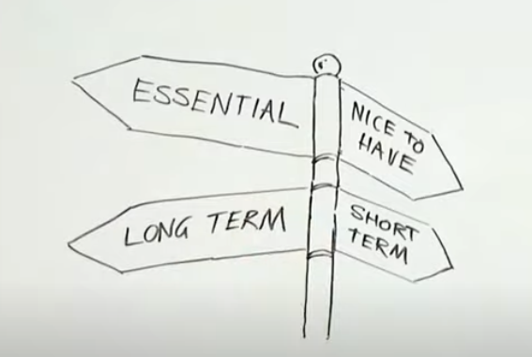
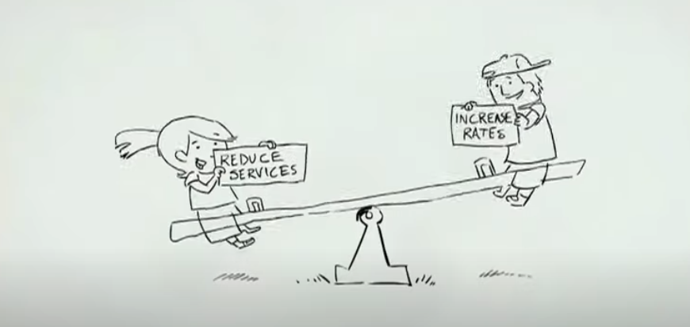
The Balance – Decision Making Importance
What are the main decision-making criteria that needs to be considered?
Cost
Essential services
Short/long term projects & outcomes
Environmental sustainability
Health and wellness
Social & cultural impacts
Etc.
Are all the criteria equal or do some of them have more “weight” or “importance” than others?

Slide 6
Lifecycle Decision Methods
Net Present Value Analysis ( NPV)
One of the most basic forms of economic analysis, which only considers the lifecycle costs of the asset or investment alternative, is the Net Present Value (NPV).This form of analysis typically includes only financial costs and, if applicable, revenues; it is effectively the sum of all discounted costs and revenues expected through the lifecycle. This method is used when people talk about "Whole of Life Costs" or "Lifecycle Costs".
Benefit Cost Analysis ( BCA)
BCA is an extension of NPV that involves identifying and evaluating the positive and negative impacts of various options, in dollar terms, over the analysis period. The aim is to assess which option has the greatest value of benefits compared to costs. BCA is typically used when non-monetary impacts are relatively consistent between the alternatives. If impacts that are not included in the BCA are considered important and are likely to differ substantially between alternatives, then these benefits should be reported in qualitative terms and a form of Multi-Criteria Analysis considered.

Slide 7
Lifecycle Decision Methods – continued
Cost Effectiveness Analysis
When benefits cannot readily be expressed in dollar terms, and the benefits of two or more alternatives differ substantially, it can be useful to evaluate the benefits in terms of some other metric, relative to costs. This technique is called cost effectiveness analysis (CEA), and is used in the social and health sector.
Risk-Based Decision Making
For all of the above decision types, if the outcome of a decision is not known with certainty, then risk-based techniques should be incorporated. Decisions may focus on maximising risk reduction for minimum cost, or simply falling somewhere within the organisation's risk threshold for minimum cost.
Multi-Criteria Analysis (MCA)
MCA involves identifying and evaluating the positive and negative impacts of various options in non-monetary terms. MCA should be used when important benefits and costs cannot be readily quantified in dollar terms. In an MCA, the impacts of each alternative are scored based on a selection of non-monetary criteria. Each criterion is scored and typically weighted for the different options and the results used to identify preferred solutions.

Slide 8
Lifecycle Decision Methods – continued
Balancing Risk, Cost and Performance
From the techniques described, Benefit Cost Analysis (BCA), Multi-Criteria Analysis (MCA) and Risk-Based methods are all appropriate to use when making decisions that balance performance, risk and cost, which is a principle of ISO 55001. Examples of decision criteria follow:
Performance: Community satisfaction, asset output, service level, etc.
Risk: Risk to the asset user, risk of failure, risk of service interruption, safety risk, reputation, etc.
Cost: Cost of ownership, operations and maintenance costs, profit, financial return, net present value, etc.

Slide 9

Continuum of Certainty
Risk = Likelihood X Consequence

Slide 10
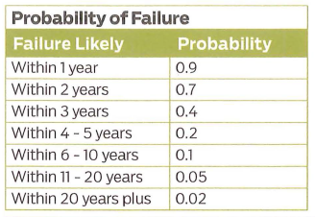
A Sample of a Likelihood Table

Slide 11
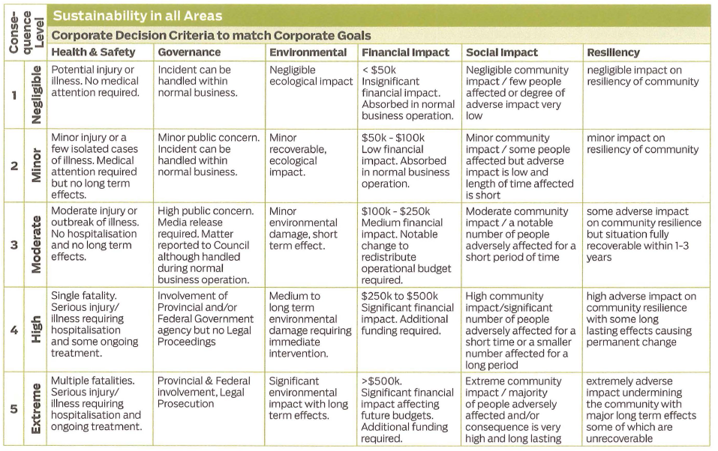
A Sample of a Consequence Matrix

Slide 12
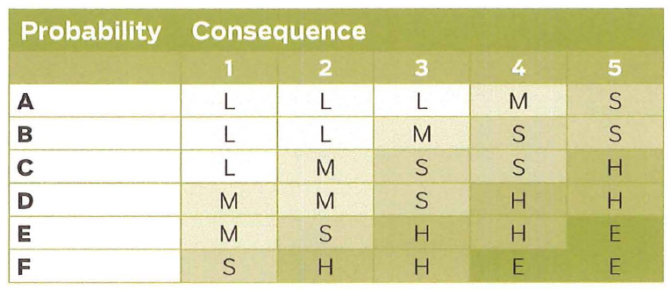
Risk Rating Matrix Example
Where should be the threshold?

Slide 13
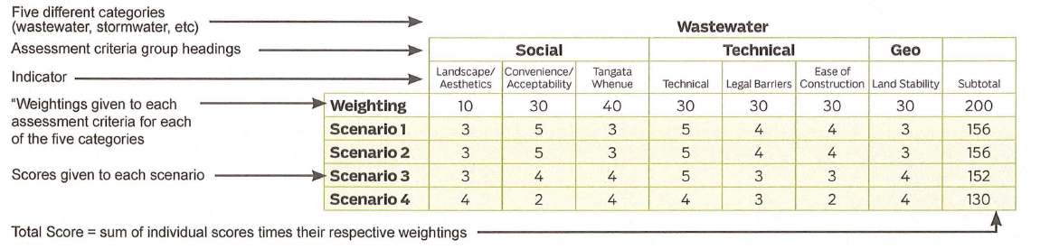
MCA Weighting Calculation Example

Slide 14
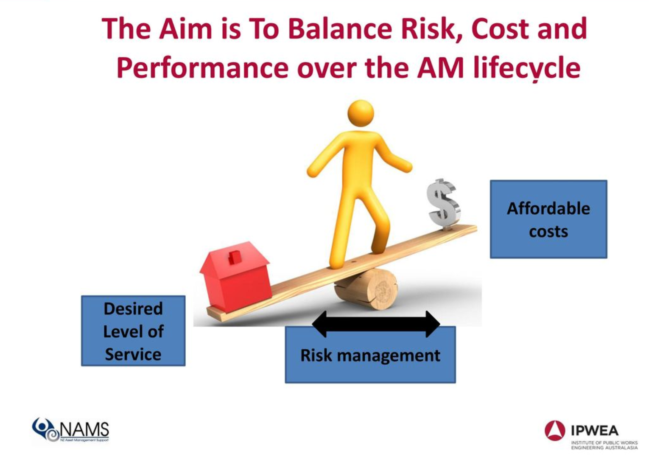
The Aim

Slide 15
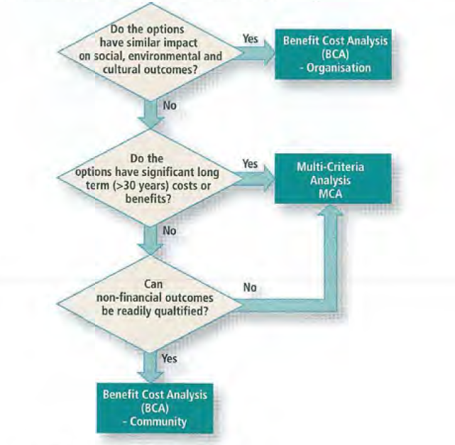
Choosing a Decision Technique
No particular decision technique is "better" than the other, as the appropriate decision technique depends on the context of the decision, and data availability.
For example, if the organisation is aiming to balance social, environmental and economic costs (i.e., is prepared to pay more for a more socially or environmentally sustainable option), then using a technique that focuses only on the organisation’s costs, such as Net Present Value analysis, is unlikely to deliver the right solution.
Understanding the decision objectives, criteria and availability of data suggests processes to follow to chose an effective technique such as this figure.

Slide 16
A Scenario
Imagine a private train operator has a contract with the government to provide a reliable train service. The contract implies that the contractor need to deliver a 90% punctuality against the train timetable. However, by providing <90% there will be a penalty of $100k for each percentage and a reward of $50k for each percentage greater (>90%). Contractor is required to adhere to the health and safety regulations.
Think about the maintenance and rehabilitation procedures that the operator should consider.
How can the operator maximise the operational delivery?
How should the operator maximise the benefits while keeping the operations safe?
Urban Train Network in Melbourne:
226 six carriage trains
998 kilometres of track
450,000 customers / day
15 lines
222 stations
(Not related to the above scenario. Only to give some context)

Slide 17
Team Exercise (10 minutes)
Create teams of 4 - 6 members
Each member of the team to represent an imaginary government department. Choose who is representing what department. (1-2 minutes)
Department of Education
Department of Transport
Department of Environment, water and planning
Department of Health
Department of Justice
Department of Treasury (must be chosen and responsible for time keeping)
Each department (except department of treasury) to propose a project (1-2 minutes thinking and 1-2 minutes talking to the rest of the team) with the below information:
Project title
Cost of the project ($10 -50 million)
Current Risks (1-3 points)
Future Risks (1-3 points)
Current service delivery (performance) (1-3 points)
Proposed service delivery (performance) (1-3 points)
Treasury to develop a table to score each project
Each team member to present their project to the department of treasury (representative)
Treasury to allocate funding of $100 million to the projects and present (2 minutes) the outcome with justification to the rest of the team. Who received funding and who did not?

Slide 18
Team Exercise - Thoughts
What were the challenges to present your project to the Treasury to attract funding?
Did every team member use the same format to present?
How did Treasury assess and evaluate the projects?
What decision-making method can be effectively used?

Slide 19
Decision Making Considerations
Prioritising vs Optimising
High cost – high benefit
Organisation objectives
Decision Making with Low Confidence
Delphi Technique
Participatory data collection
Confidence Level
alert decision makers to the risks of making a decision with the level of confidence in the results.
Sensitivity Testing Decision Outcomes

Slide 20
Discussions / Questions

